Slide 3
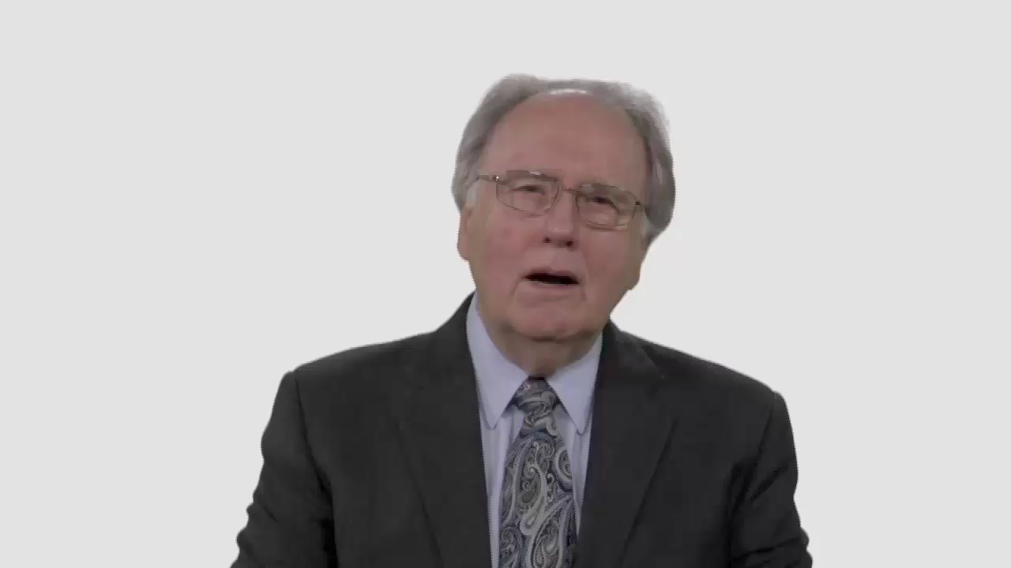

Slide 4
Have Your Say.
Is being active in social issues
or being engaged with questions
on the public agenda a
distraction from our mission?

Slide 5
Conversation Builders.
When people urge the church
to be more culturally relevant,
what changes do you think
they’re looking for?

Slide 6
Conversation Builders.
What’s the difference between
a church that’s trying to be “cool” and a church that’s trying to be “real”?

Slide 7
Discussion Questions.
Could our convictions about
end-time events sometimes
contribute to a sense of
isolation from society?

Slide 8
Discussion Questions.
Are there social issues that
particularly mesh with Adventist values—issues that would allow
us to make a unique contribution?

Slide 9
Discussion Questions.
Would your community
notice if your church
suddenly wasn’t there?

Slide 10
Discussion Questions.
Are there any dangers for
the church in taking up
issues on the public agenda?

Slide 11
What Now?
Is there a project your local church
or youth group could take on that would help make Adventist values
real to your community?

